Slide 1

Natural Language Processing for Customer Insight Analysis
TEAM - 5
Ajesh Thundathil Ashok Kumar (u1152569) Resmi Sankar Sreelatha (u1146817) Sanila Nair (u1160853)
University of Southern Queensland May 01, 2024
. . . . . . . . . . . . . . . . . . . .
. . . . . . . . . . . . . . . . . . . .
1 / 20

Slide 2



Agenda
Introduction
Problem Statement
Dataset Overview
Methodology
Results
Ethical Assessment
Conclusion
References
Appendices/Additional Notes
Git Collaboration
Presentation link

Slide 3

Project Overview
Problems faced by the client:
Overwhelmed by customer inquiries
Losing customers to competitors
The overall objective of the project
Analyze reviews with NLP
Identify patterns, assess sentiments
Establish QA system
Develop ethical, transparent system suitable for real-world use
The significance of the intended solution
NLP filters reviews, identifies improvements.
QA system automates exchanges, speeds service.
AI enhances market position, customer engagement.
Boosts efficiency, trust, and commercial value.

Slide 4

Problem Statement
A QA system manages customer inquiries with privacy compliance.

Slide 5

Dataset Overview
The "Amazon Customer Reviews dataset " provides textual reviews, product ratings, and information for NLP analysis related to the e-commerce client.
35000 records.
The features of the dataset are:
product name
ratings
reviews
date

Slide 6
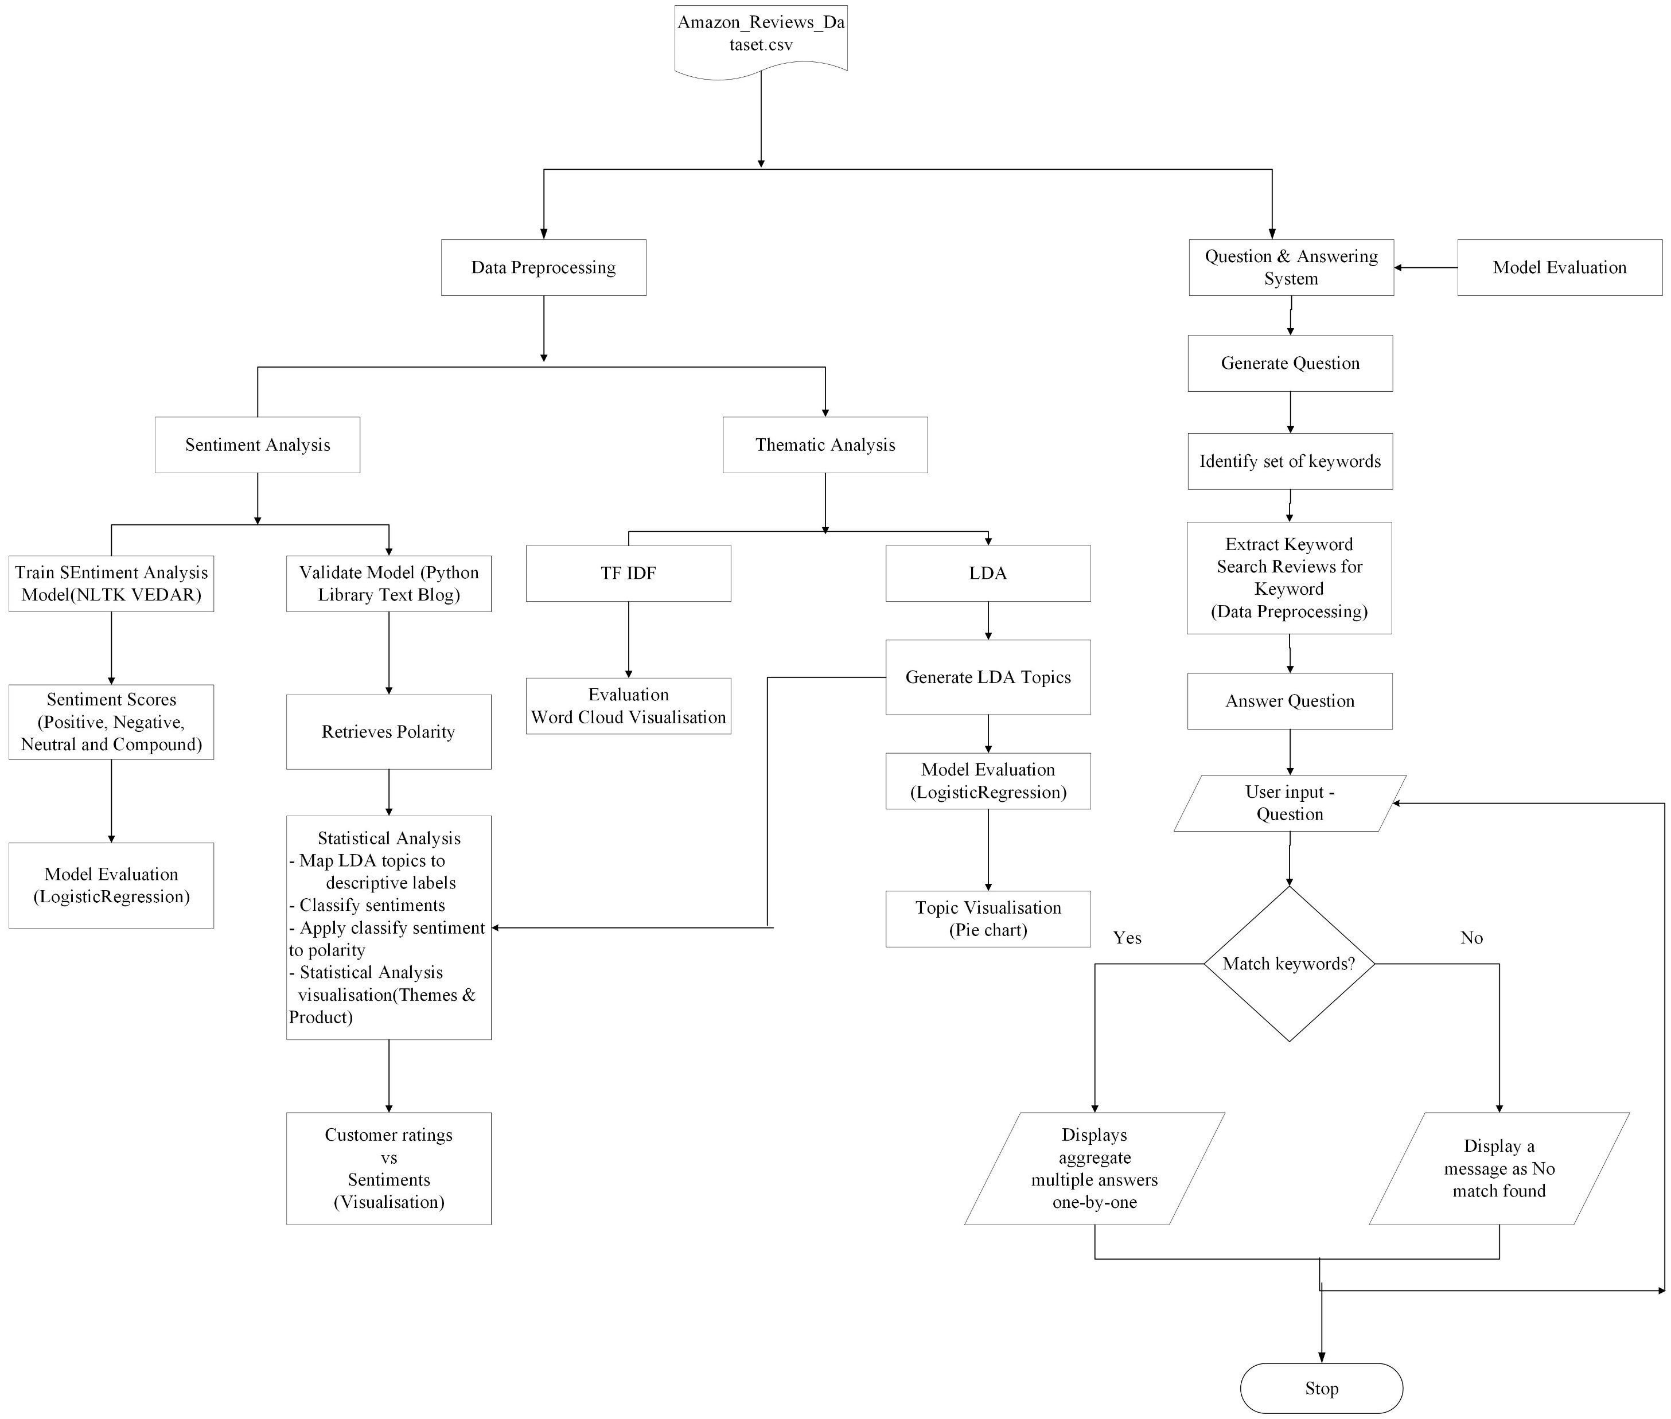
Project Methodology
Figure: Consider diagrams like flowcharts to economies information for time

Slide 7
Thematic Analysis for Product Improvement
TF-IDF Score
Analyzing Common Words -TF-IDF (Term Frequency-Inverse Document Frequency)
TF (Term Frequency)
IDF (Inverse Document Frequency)
TF-IDF Score
NLP Library: sklearn.feature_extraction.text, TfidfVectorizer
From Dataset clean and preprocesse Amazon reviews , then transformed them using TF-IDF Vectorization to identify key themes.
Utilize LDA for systematic topic identification in textual content NLP Library: Gensim: LdaModel Implemented LDA by preprocessing text, configuring the model, training it, and assigning topics to documents
Optimal Method : LDA
Top 4 words by TF-IDF score:
Word | TF-IDF Score
great | 1654.3071980850261
love | 1398.5597314577076
good | 1350.60417176355
product | 1054.1918369405093
LDA Topic
(4, '0.072*"pain" + 0.036*"taking" + 0.029*"turmeric" + 0.023*"joint" + 0.023*"product" + 0.023*"take" + 0.022*"inflammation" + 0.015*"arthritis" + 0.015*"knee" + 0.015*"helped" + 0.014*"capsule" + 0.014*"supplement" + 0.014*"talk" + 0.011*"public" + 0.010*"class" + 0.010*"relief" + 0.009*"turmeric" + 0.009*"recommended" + 0.008*"curcumin" + 0.008*"difference" + 0.007*"information" + 0.006*"drop" + 0.006*"brand" + 0.006*"pepper" + 0.006*"effective" + 0.005*"god" + 0.005*"effect" + 0.005*"daily" + 0.005*"lower" + 0.005*"feel" + 0.004*"use" + 0.004*"delicious"')

Slide 8
Sentiment Analysis
Preprocess the data to remove irrelevant information or noise.
Train a sentiment analysis model using an appropriate NLP library. TextBlob (Polarity, Subjectivity)
Validate the model with a separate test set and document its performance.(Logistic Regression).
Train and Test (80%, 20%)
How good the Accuracy and F1 Score by training the model
Conduct a statistical analysis to present the distribution of sentiments (positive, negative, neutral) across various products and previously identified themes. Vadar(Positive , Negative , Neutral, Compound score )
Statistical : Mean , std, IQR , min ,max
Top 10 Stacked Bar Visualization
Examine the relationship between customer ratings and sentiments extracted through sentiment analysis to distinguish any patterns or discrepancies.(Visualizations)
 | SENTIMENT SCORES
Text | Positive score | Negative score | Neutral score | Compound score
product exceeded expectation complaint cologne... | 0.390 | 0.110 | 0.500 | 0.9531
terrible knock ordered received immediately co... | 0.100 | 0.100 | 0.799 | -0.2500

Slide 9
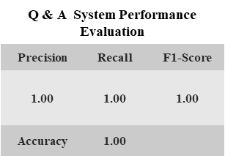
Simple Question Answering System
Identify FAQs: Team framed 47 Questions Question : What is the recommended dosage for Turmeric Curcumin? Answers :1. I've been using Turmeric for several years now. 2. Turmeric and other herbs are an amazing part of feeling good.
Matching Algorithm Development: Developed a matching algorithm to link questions with answers by extracting relevant keywords from questions and searching for matching sentences in reviews.
NLP Techniques: Utilized Natural Language Processing (NLP) techniques to enhance the search mechanism, including keyword extraction, regular expressions, and sentence tokenization (sent_tokenize, word_tokenize, pos_tag), to refine the search process for accurate information retrieval for precise search.
Accuracy and Relevance: Evaluated the system's performance using metrics such as precision, recall, F1 score, and accuracy, ensuring the most accurate and relevant responses to user queries.
User-Friendly Interface: Designed the system to be user-friendly, allowing users to input questions easily and receive prompt, relevant answers. Can be seamlessly integrated with e-commerce platforms for efficient customer support.

Slide 10
Results Section
The results are categorized into three main sections:
Thematic Analysis
Sentiment Analysis
Question Answering System Performance

Slide 11

Thematic Analysis Results
z

Slide 12
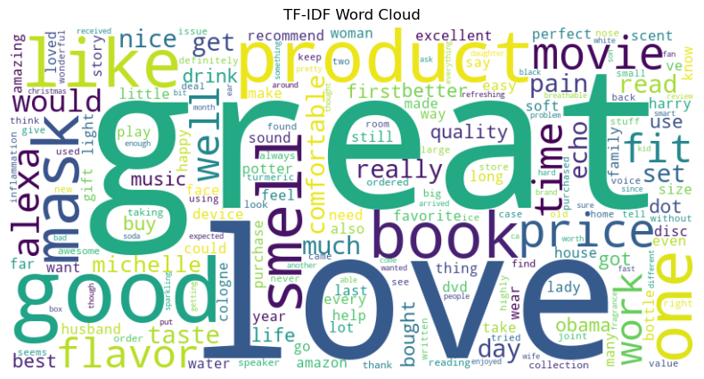
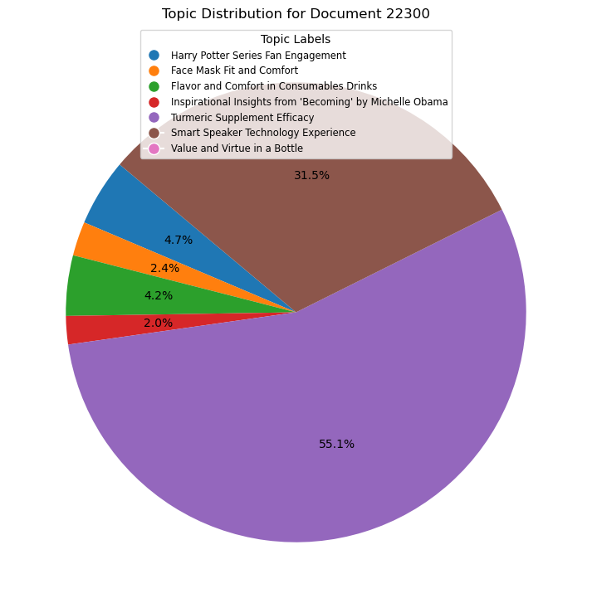
Figure 1
Figure 2
LDA-Logistic Regression Model Evaluation
Topic | Precision | Recall | F1-Score
0 | 0.86 | 0.77 | 0.81
1 | 0.93 | 0.91 | 0.92
2 | 0.92 | 0.91 | 0.92
3 | 0.79 | 0.77 | 0.78
4 | 0.71 | 0.82 | 0.77
5 | 0.84 | 0.69 | 0.76
6 | 0.84 | 0.88 | 0.86
Overall Accuracy |  | 0.86
Table

Slide 13

Sentiment Analysis Results
z

Slide 14
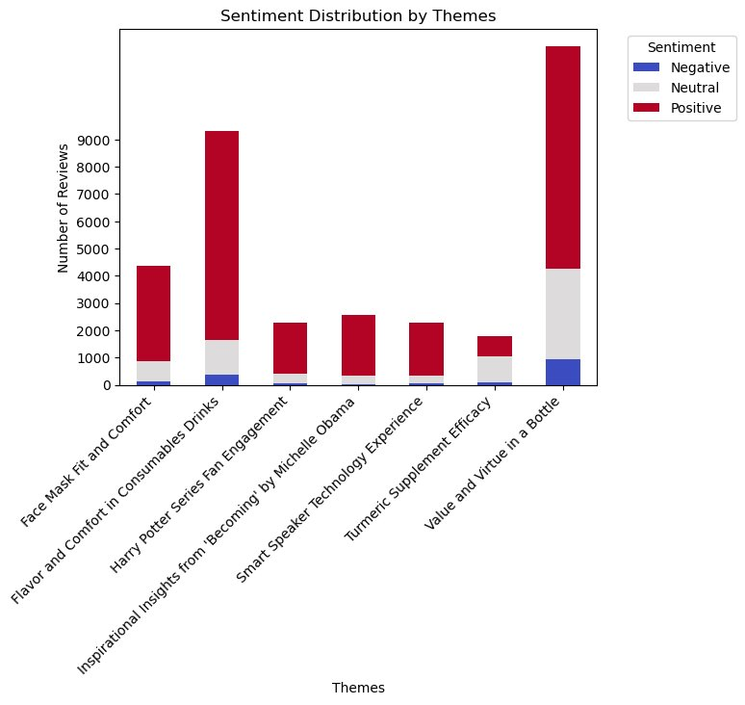
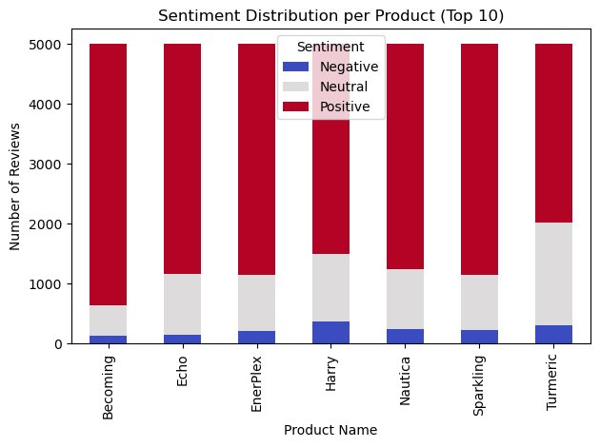
Figure 2
Figure 1
Sentiment Analysis validation performance evaluation (Classification Report)
Sentiment | Precision | Recall | F1-Score
Positive | 1.00 | 1.00 | 1.00
Negative | 0.98 | 0.97 | 0.98
Neutral | 0.95 | 0.96 | 0.95
Accuracy | 0.99
STATISTICAL SUMMARY OF SENTIMENT COUNTS
Sentiment | Negative | Neutral | Positive
count | 7.000000 | 7.000000 | 7.000000
mean | 234.714286 | 1031.285714 | 3734.000000
std | 87.629360 | 357.000333 | 420.679213
min | 131.000000 | 505.000000 | 2975.000000
25% | 177.500000 | 933.500000 | 3630.000000
50% | 226.000000 | 1010.000000 | 3841.000000
75% | 277.000000 | 1063.000000 | 3849.000000
max | 377.000000 | 1710.000000 | 4364.000000
Table 2
Table 1

Slide 15
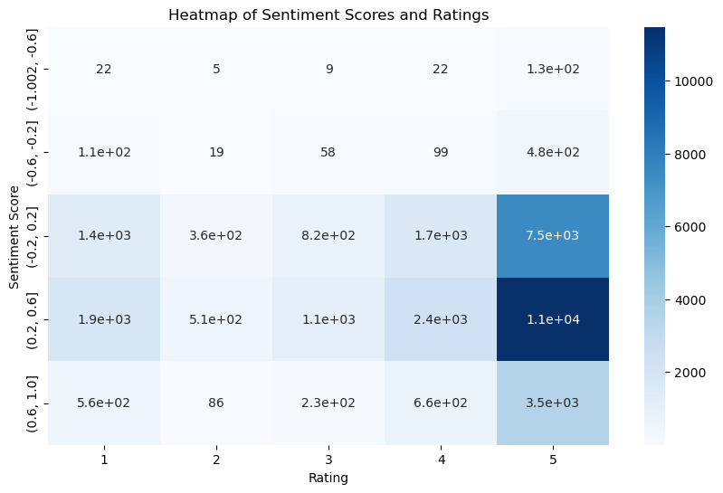

Slide 16

Question Answering System Results
z

Slide 17
Welcome to the Customer Insights QA System. Ask a question or type 'quit' to exit. Your question: What is the recommended dosage for Turmeric Curcumin? Answers – 1 . This turmeric has helped with all the chronic pains I’ve suffered with and endured for 30 years.
2. I've been using Turmeric for several years now.
3. Turmeric and other herbs are an amazing part of feeling good.
4. These have a weird taste that I haven't noticed with other Turmeric Curcumin supplements.
5. What I love about the product is that you can smell the turmeric, unusual for a capsule. Your question: Quit Thank you for using the QA System. Goodbye!
User Testing
Q & A System Performance Evaluation
Precision | Recall | F1-Score
1.00 | 1.00 | 1.00
Accuracy | 1.00

Slide 18
Ethical Assessment
Key principles for data privacy and bias are needed for integrating ethics across the NLP project and consider deployment:
Best Practices in Ethics
Protection of Customer Privacy
Bias Mitigation
Data retention (Loss of data)
Ethical System Interactions
Transparent Data Handling

Slide 19
Ethical Assessment - Review Plan
Consider the GDPR-based structured ethics review approach for QA system implementation and monitoring:
Pre-Deployment Ethical Review
Post-Deployment Monitoring
Feedback Integration
Transparency and Communication

Slide 20
Conclusion
Project Findings:
Identified key themes: Analyzed customer reviews to identify prevalent themes such as product quality, customer service, and shipping experience.
Uncovered sentiment distribution: Examined sentiment distribution across different product categories and themes to understand customer perceptions.
Recognized areas for improvement: Identified areas where customers expressed dissatisfaction or suggested enhancements, such as packaging, product variety, and website usability.
Recommendations:
Enhance product quality: Address customer concerns regarding product durability, effectiveness, and packaging to improve overall satisfaction.
Streamline customer service: Implement strategies to expedite response times, improve communication channels, and enhance customer support experiences.
Optimize website functionality: Enhance website navigation, product descriptions, and checkout processes to provide a seamless and user-friendly shopping experience.
Potential Impact on Enhancing Customer Interactions:
Improved customer satisfaction: By addressing key concerns and implementing product improvements, customer satisfaction levels are expected to increase.
Enhanced brand loyalty: Providing personalized responses, proactive support, and efficient resolutions can foster stronger connections with customers and increase brand loyalty.
Increased competitiveness: By continuously refining products and services based on customer feedback, the company can stay ahead of competitors and maintain a strong market position.

Slide 21
References
Kerry, C. F. (2020). "Protecting privacy in an AI-driven world.“
Varona, D. and J. L. Suárez (2022). "Discrimination, bias, fairness, and trustworthy AI." Applied Sciences 12(12): 5826.
https://gdpr-info.eu/

Slide 22
